Slide 1
Respiratory Disease Detection using Cough Sounds
Machine Learning Approach
Team Quadcore:
Adhar Chaudhari (RVCE25BIM043)
Tejash Pathak (RVCE25BCS401)
Abhinandan Jaiswal (RVCE25BCV044)
Ishan Jain (RVCE25BAI184)
RV College of Engineering, Bangalore

Slide 2
Objectives:
To develop a cough-analysis ML pipeline, including feature extraction
and model training.
To build a functional web-based interface that records cough audio
and delivers screening results.

Slide 3
Target:
Collect and preprocess cough audio data.
To extract meaningful audio features for disease prediction.
To train and evaluate machine learning models for respiratory disease detection.
To develop a web-based system for real-time cough analysis.
To enable fast, non-invasive respiratory screening using AI.

Slide 4
Achieved:
Cough audio data collection and preprocessing completed.
Audio feature extraction implemented.
Machine learning model successfully trained and tested.
Basic web interface for cough recording and prediction developed.
Collect and preprocess cough audio data.
To extract meaningful audio features for disease prediction.
To train and evaluate machine learning models for respiratory disease detection.
To develop a web-based system for real-time cough analysis.
To enable fast, non-invasive respiratory screening using AI.

Slide 5



Introduction & Project Overview
The Problem
Respiratory diseases (e.g., COPD) are a leading global cause of death
Diagnostics rely on subjective human hearing
Human accuracy for cough-based diagnosis: as low as 34%
The Solution
AI analyzes 300+ acoustic features from a single cough
Far exceeds human perception capabilities
Develop a non-invasive diagnostic tool that records audio, extracts features, and classifies respiratory conditions using ML
System Architecture
User Layer
ML Layer
Result Layer
Browser-based recording
Python/Librosa feature extraction
Real-time classification display

Slide 6




Stage 1: Raw Audio to Data
Objective
Enhanced Features
Convert raw cough audio into numerical feature vectors for machine learning analysis.
Extracts over 300 acoustic features, far exceeding human perception, for richer AI datasets.
Framework & Tools
Language: Python
Workflow Overview
Audio Loading
Resampling
Ingest cough sound files.
Standardize audio sampling rates.
Frame Computation
Aggregation
Process audio segments for detailed feature calculation.
Calculate mean/std dev across frames to form feature vectors.

Slide 7




Stage 1: Key Acoustic Features Extracted
Key Acoustic Features
MFCCs
Chroma Features
Captures spectral envelope, crucial for identifying cough types.
Analyzes pitch distribution, detecting harmonic variations in coughs.
Spectral Contrast
Zero-Crossing Rate (ZCR)
Measures spectral peak-valley differences, characterizing sound texture.
Quantifies signal noisiness, indicating 'dry' vs. 'wet' coughs.
Output Structure
Vector Size: Fixed-size vectors (70-80 features) ensure consistency regardless of audio length.
Format: Features saved as CSVs for seamless ML integration.

Slide 8
Stage 2: Machine Learning Model Training
Addressing Data Imbalance for Robust Detection
Dataset Overview
Total Samples: 3,941 cough audio feature sets.
Challenge: Severe class imbalance: 76.3% healthy vs. ~23.7% disease/infection.
Initial Result: Models achieved high accuracy (~87%) but failed disease detection due to imbalance.
Random Forest Classifier
Support Vector Machine (SVM)
Logistic Regression
Best-performing model selected.
Explored for classification.
Baseline model for comparison.
Optimization Strategy
SMOTE & Class Weight Adjustments
Cough Quality Filtering
Handled severe class imbalance; models learn from minority classes.
Dataset filtered by "Cough Quality" confidence (≥ 0.7) for reliability.

Slide 9


Stage 2: Model Performance & Insights
Balanced Sensitivity for Real-World Application
Selected Model: Random Forest
Performance Metrics
Random Forest model, with a 0.7 threshold, achieved balanced performance.
Accuracy: ~51% (Realistic for imbalanced data, shows true detection).
Macro F1-Score: ~0.43 (Improved detection for rare classes like Obstructive Disease; balanced precision/recall).
Key Insight: Balances sensitivity across "Upper Infection," "Lower Infection," and "Healthy," moving past superficial accuracy.
Top Predictors (Feature Importance)
Biomarkers
Acoustic Features
Age: Strongest predictor for respiratory disease detection.
Mel spectrogram stats & harmonic pitch variations: Crucial for sound analysis.

Slide 10

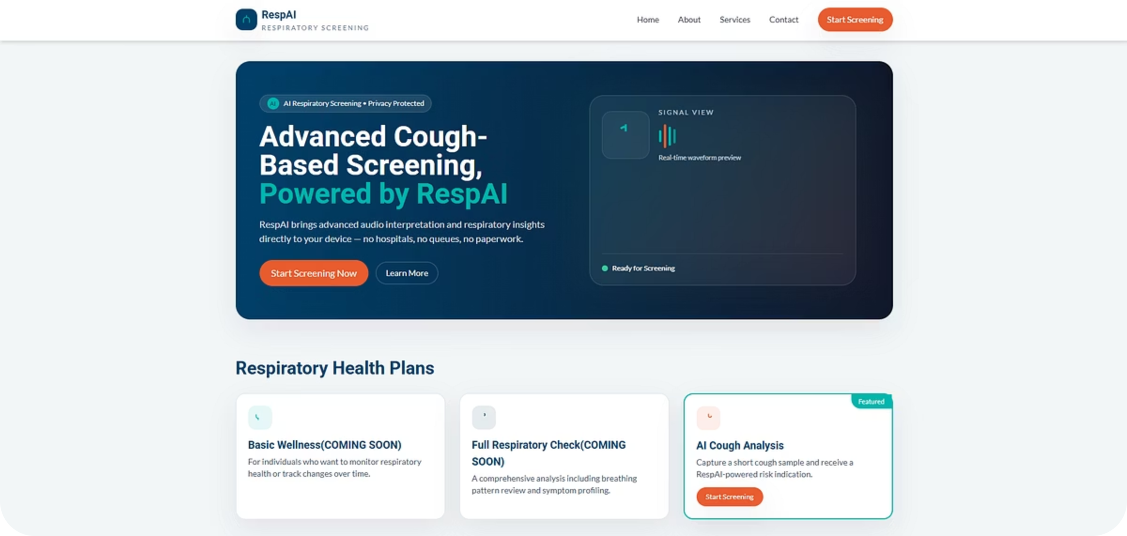
Stage 3: RespAI Web Interface
AI Diagnostics for Users
Tech Stack
Workflow
Frameworks: HTML, Tailwind CSS, JavaScript.
Consent: Users agree to data processing; ensures privacy.
Key API: MediaRecorder for browser microphone audio capture.
Recording: Visual pulse and timer guide cough capture.
Results: Displays risk levels (Low/Moderate/High) for immediate feedback.

Slide 11

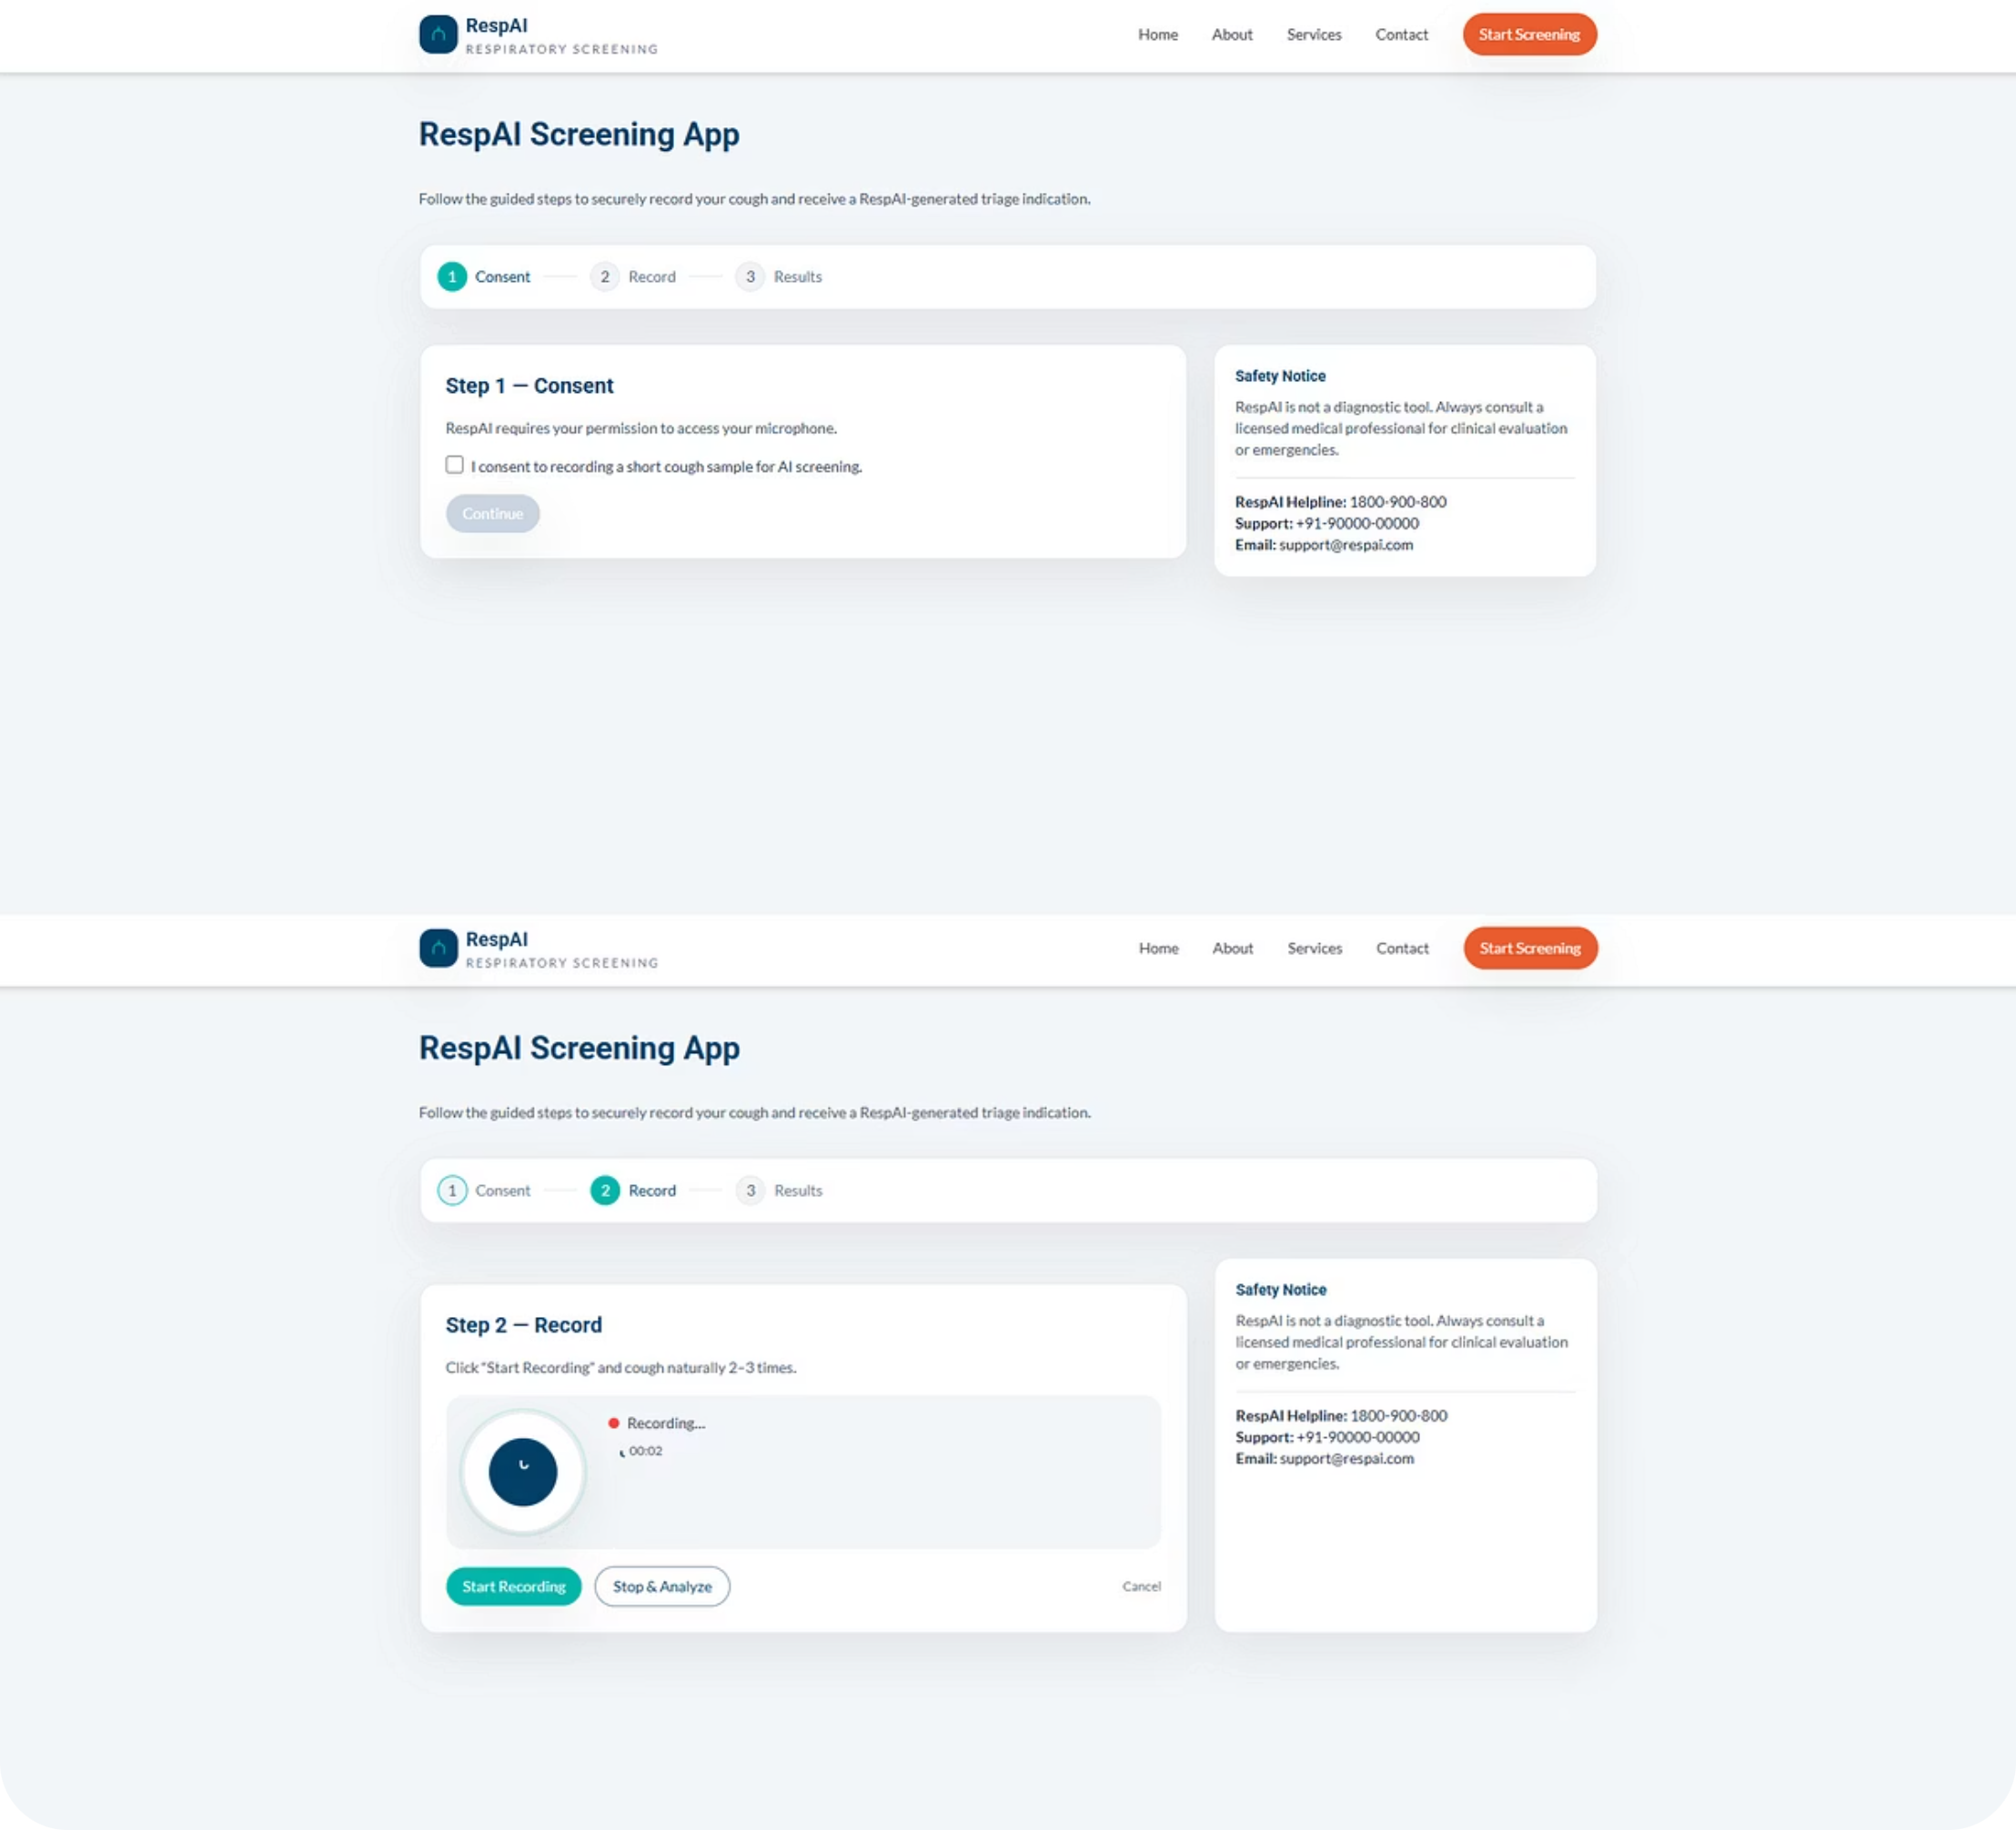
Stage 3: User Experience & Simulation
Responsive Design & Initial Functionality
Current Features
Responsive Design: Adapts seamlessly to desktop and mobile for broad accessibility.
Error Handling: Alerts user if microphone access is blocked, guiding resolution.

Slide 12
Stage 4: Backend Architecture
Engine for Diagnostics
Technology
Current Status
Server: Built with Python and Flask, offering a lightweight yet powerful foundation.
File Handling: Backend securely receives and temporarily stores audio streams.
Endpoint: Dedicated `/analyze` endpoint accepts `.webm` audio via POST requests.
Integration Ready: Placeholders exist for `.h5` deep learning model and feature extraction pipeline, awaiting integration.
Architecture Flow
01
02
03
Frontend Sends Audio
Backend Receives File
Extract Features (Pending)
Recorded audio transmitted from frontend.
Flask server securely ingests audio.
Audio processed for acoustic features.
04
05
Model Inference (Pending)
Return JSON Result
ML model analyzes features to predict risk.
Diagnostic assessment sent to frontend.

Slide 13


Conclusion & Path Forward
From Prototype to Real-World Impact
Functional Prototype
Robust Feature Pipeline
User-Friendly Frontend
Developed functional prototype, demonstrating core capabilities.
Built robust feature pipeline; identified Random Forest as best ML model.
Developed 'RespAI,' a responsive, intuitive web interface.
Future Work (To-Do)
Backend Integration
Deep Learning Exploration
Deployment
Integrate trained ML model with Flask backend for real-time inference.
Explore CNN model for higher accuracy and advanced pattern recognition.
Deploy Web App (Vercel/Netlify) and Backend (Render/AWS) for public access.

